Slide 1

Australia Influenza analysis 2008-2017
Presented by Matt Yang

Slide 2


Purpose of analysis
Get Useful Insights on Australia Influenza Situation
Understand the Ability of Forecasting Influenza Cases
Guide investment decisions in medical and health area
Build an internal alarming system to prepare for reserves / products and services during next pandemic

Slide 3



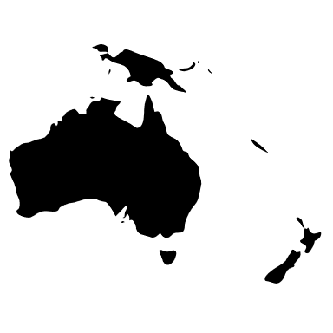


Data information & Key Questions
Individual Confirmed Influenza Cases 2008-2017
Key Questions to be addressed
Week of case recorded
How did influenza cases change over the year? Are there similar patterns across different types of influenza viruses?
Is there any difference in influenza situation across different state, gender, age group and indigenous status?
Can we build a relative accurate model to predict influenza cases for the future?
Age group the patient belongs to
Gender of the patient
State of residency of the patient
Type/subtype of influenza infected
Indigenous status of the patient

Slide 4
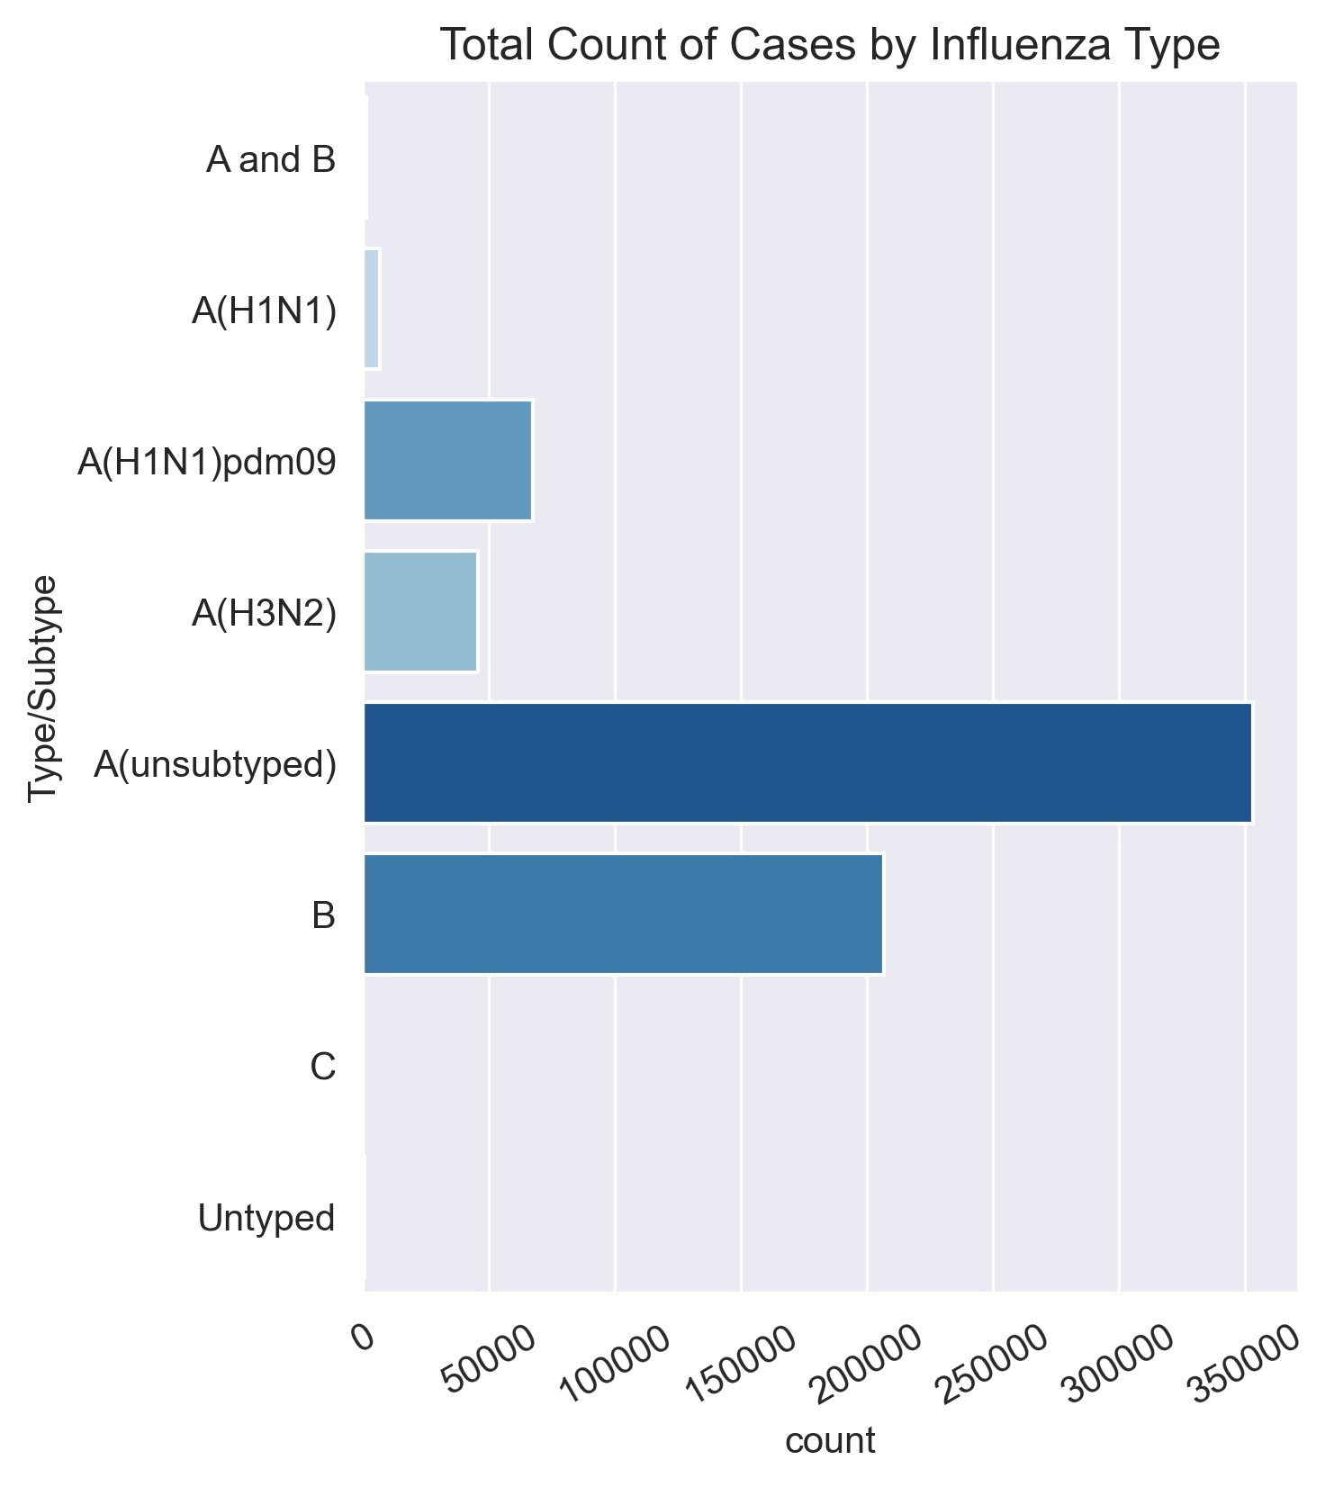
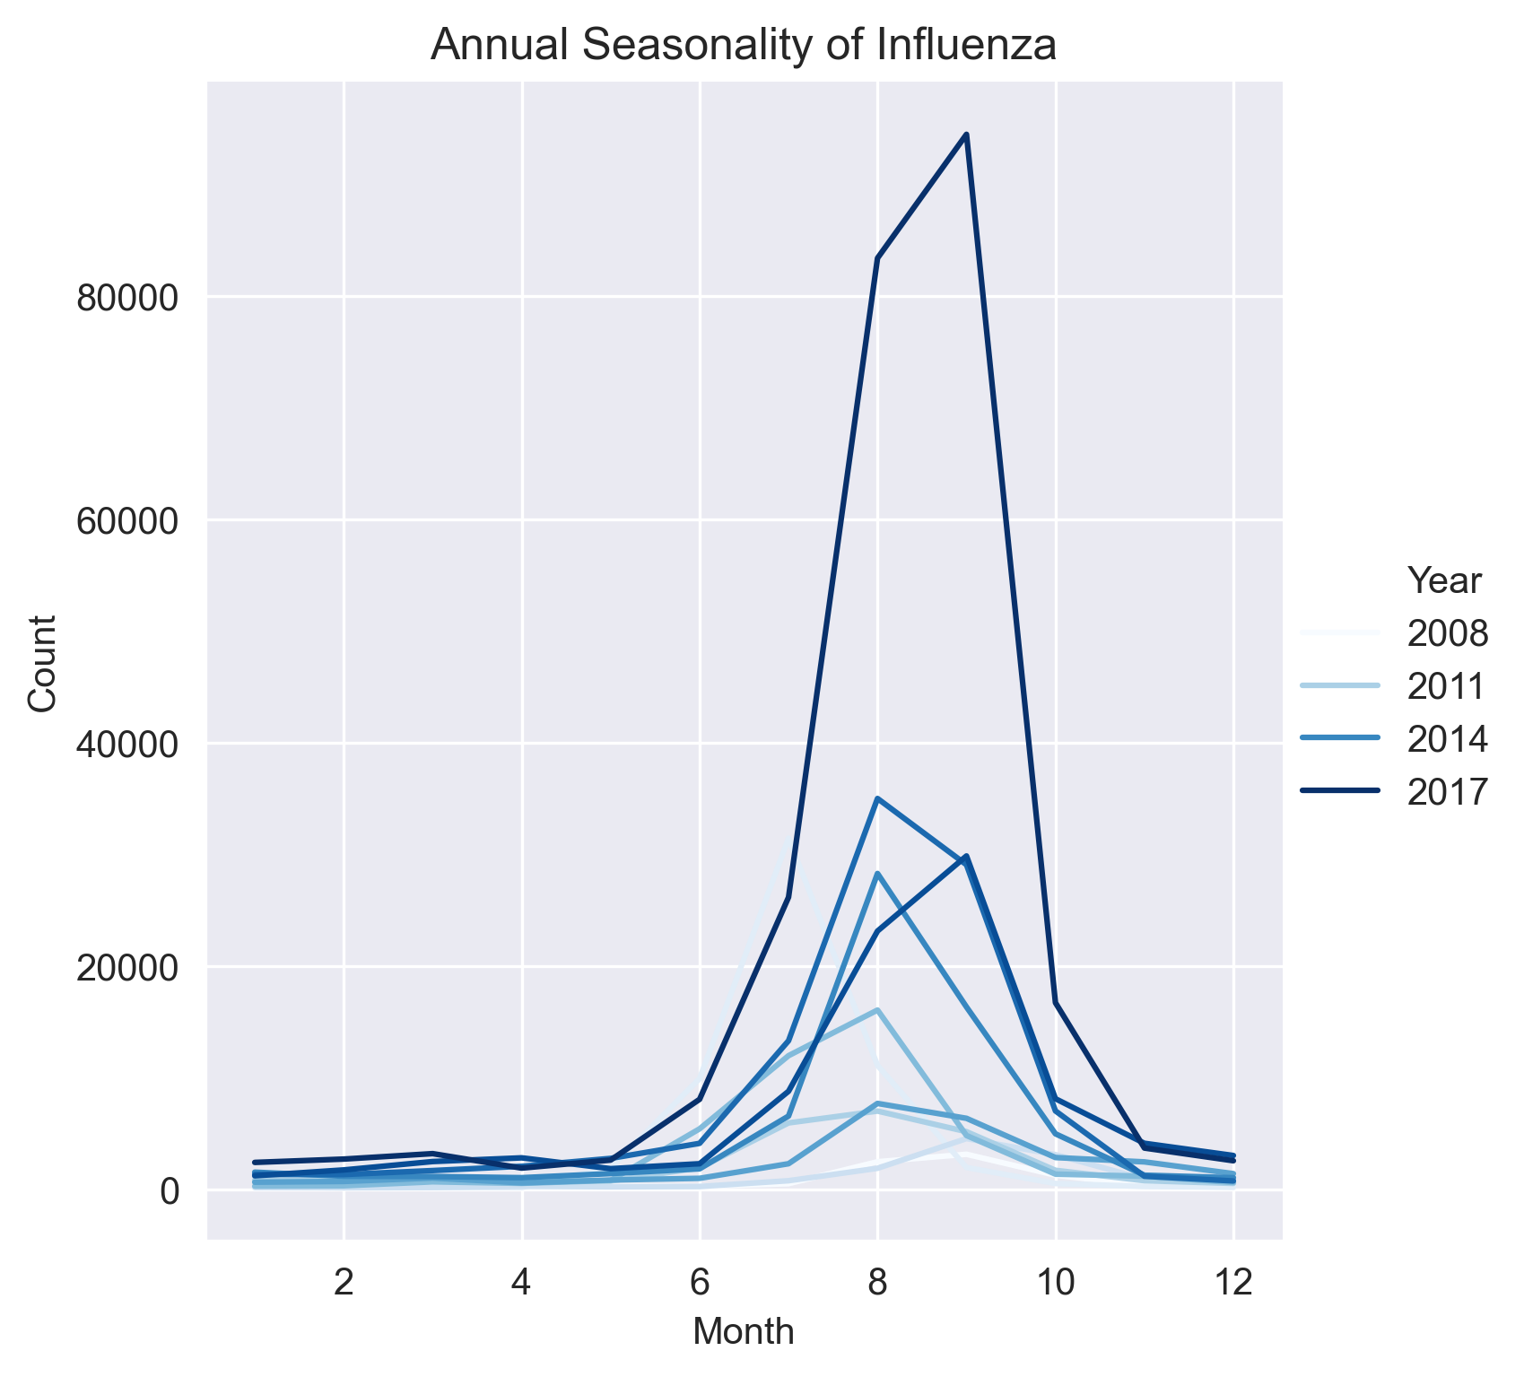
Immediate findings from data
Type A Influenza (and its subtypes) is the most common influenza in Australia
Strong seasonality in Influenza outbreaks: start from Jun, peak at Aug & Sep, and abate after Oct

Slide 5
Issues with Data & key assumptions
Main Issues with the Influenza Dataset
Assumptions
Need additional population data to calculate the infection rate instead of absolute count
Only patients who sought medical support can have case confirmed and therefore recorded -> the data is not fully representative
The dataset lacks information on human interventions and activities (such as the use of vaccines and rising public awareness)
Population is relatively constant within each year. (Gather data from ABS)
Gender and Age structure is similar across states.
People’s behaviors and the medical condition in each state is similar.
The young population (14 years old or lower) and elder population (70+) are very likely to seek medical support if they are infected.

Slide 6
Section 1: Insights exploration
1.1 Overall Trend analysis & Influenza type analysis

Slide 7
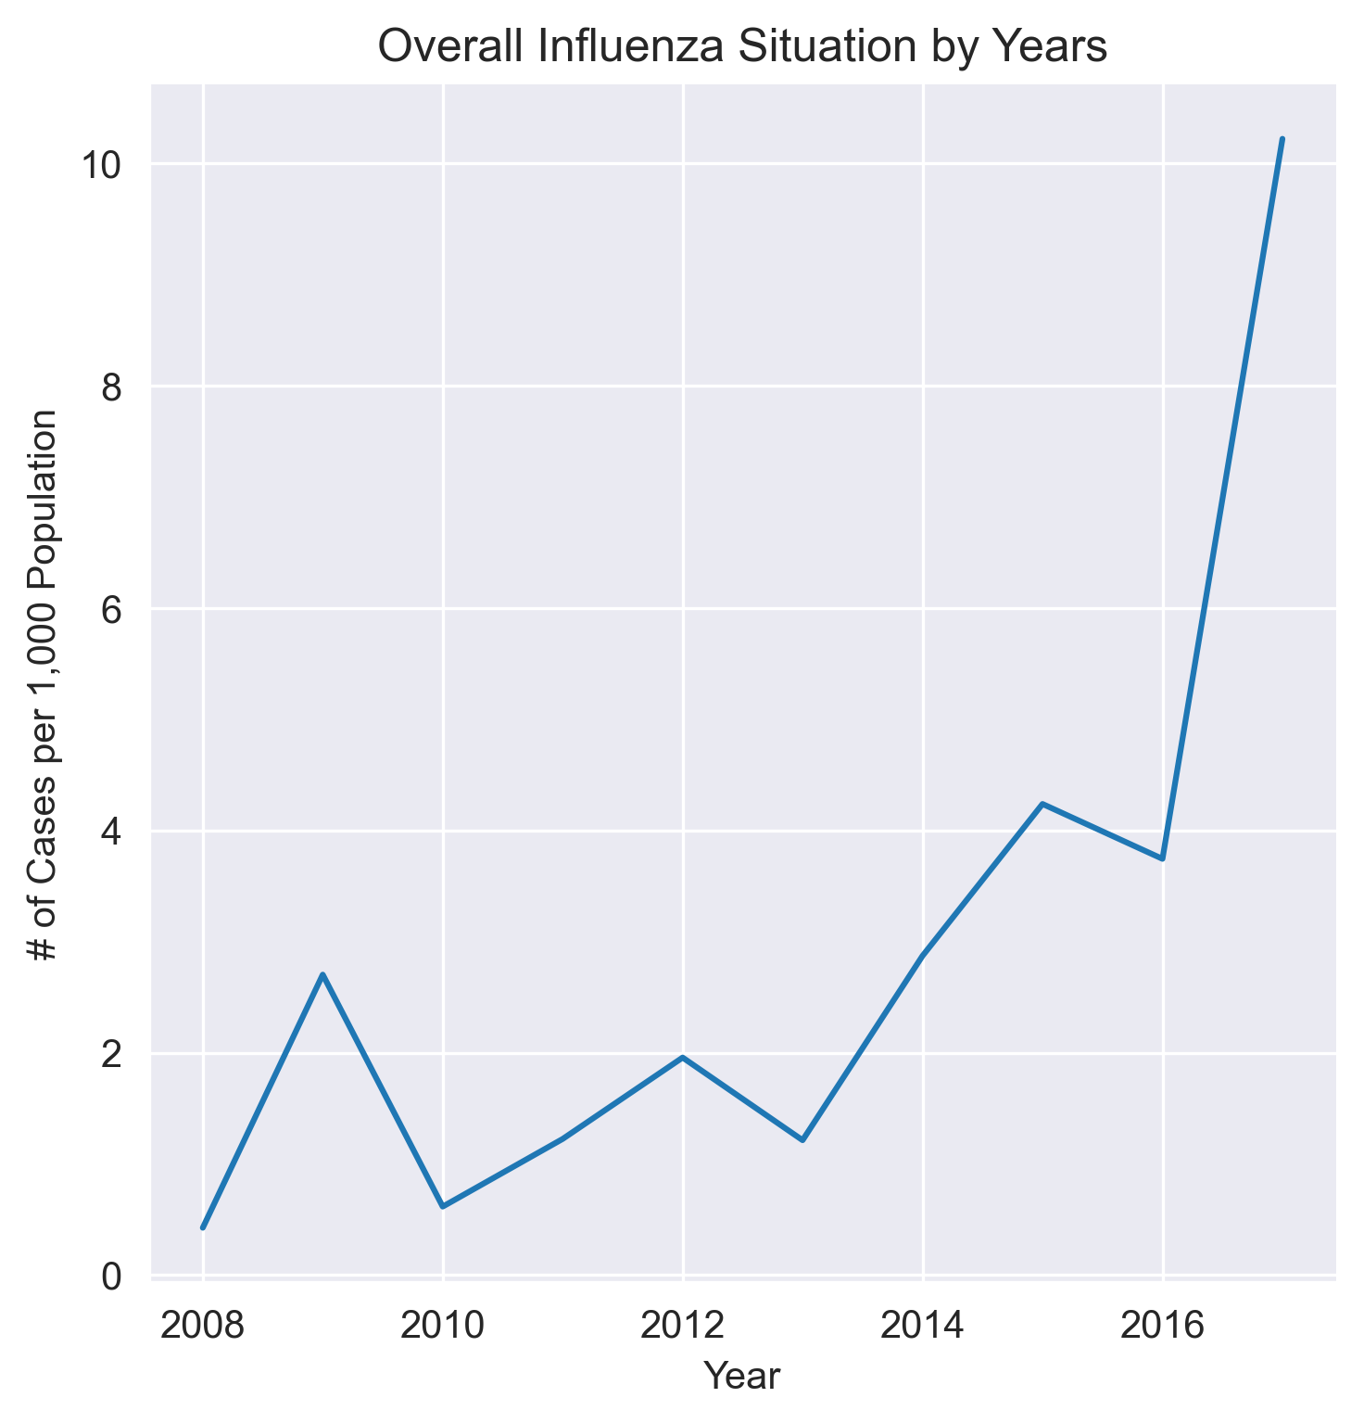
Overall Increasing trend with cyclical effect
Insights & Findings
Overall increasing trend in influenza cases in Australia.
Cannot just simply tell the absolute severity -> No information such as the changes in testing policies, awareness campaigns, etc.
Cyclic trend from 2010 to 2016: the cases/1,000 pop increased by 2 years then drop the next year after.
One possible reason is human intervention (e.g. R&D for vaccines, level of attention) has a 2-year cycle but each response is only effective for 1 year.
some cyclical effect

Slide 8
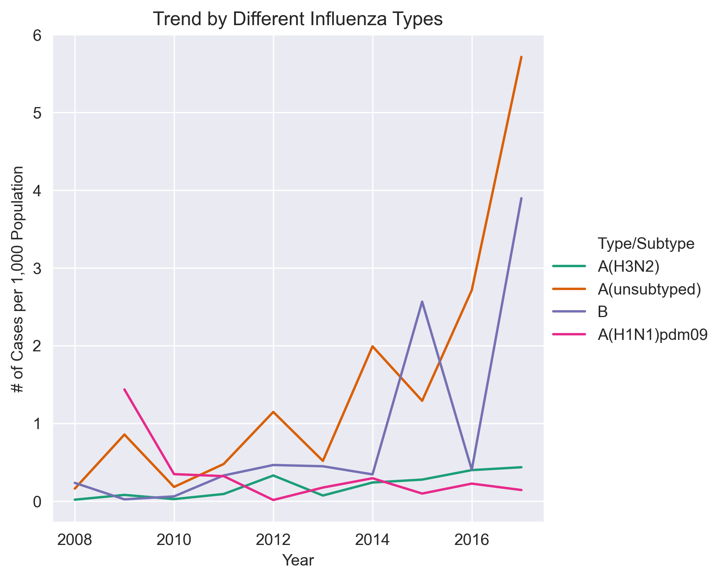
General Type A Influenza is the main driver of trend
Insights & Findings
Trend of general type A influenza ≈ Overall Influenza Trend.
Except for 2009 A(H1N1) Pandemic & 2016 type B outbreak.
Type B Outbreak
2009 H1N1 Pandemic

Slide 9
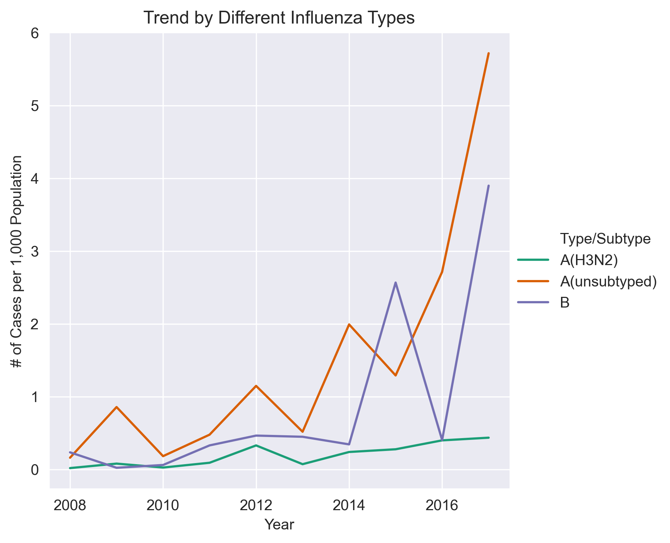
Human intervention suppresses influenza after historical peak
Insights & Findings
Trend of general type A influenza ≈ Overall Influenza Trend.
Except for 2009 A(H1N1) Pandemic & 2016 type B outbreak.
New historical peak in one year -> suppressed in the following year.
Intuitive as people get more alerted in a peak year and take actions to prevent.
Only exception is still 2017, where type A influenza worsened even more after a peak in 2016.

Slide 10
Section 1: Insights exploration
1.2 Gender & age group analysis

Slide 11
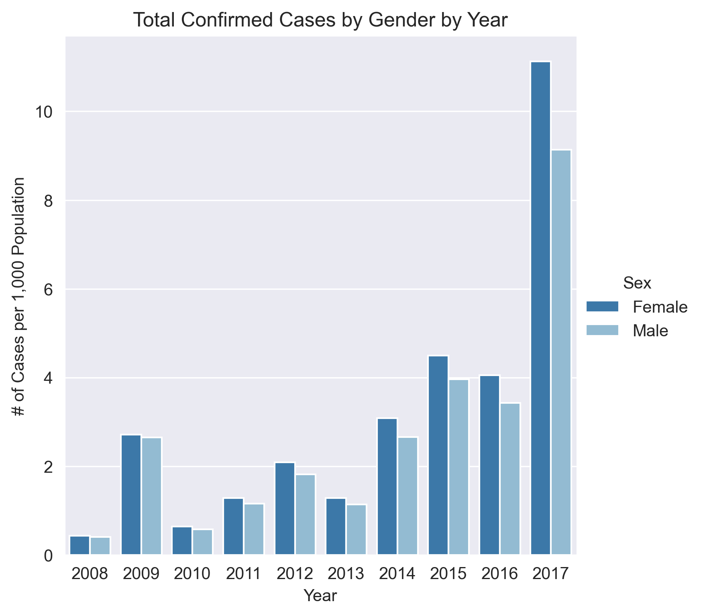
Total confirmed cases are more on Female acr0ss years
Insights & Findings
Consistently higher total cases per 1,000 population for females than males.
Paired-sample t-test yields a p-value 0.04, suggesting there is difference by gender.
Cannot conclude females are more vulnerable -> females may seek medical support more actively.
Introduce Age Groups into analysis

Slide 12
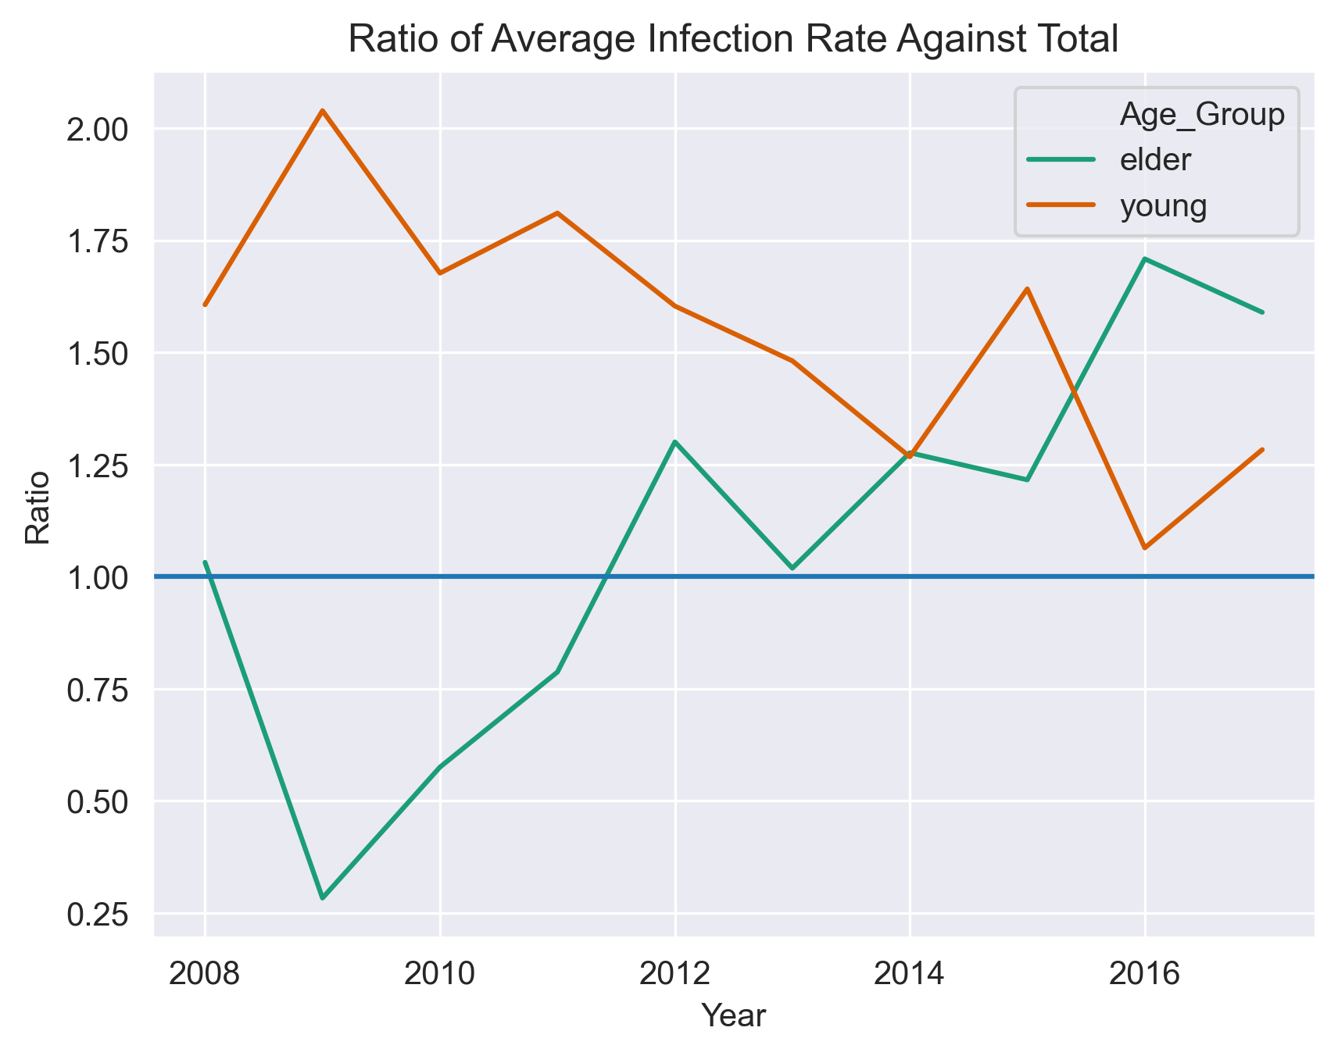
Elder and young populations are major victims of influenza
Insights & Findings
Young (14-) and Elder (70+) populations are more vulnerable to influenza (though they are more likely to seek medical help)
Elder population get more vulnerable over the years since 2009.
Young population are overall getting more protected.
Additional: Explore influence of different types of influenza on different age groups or gender.

Slide 13
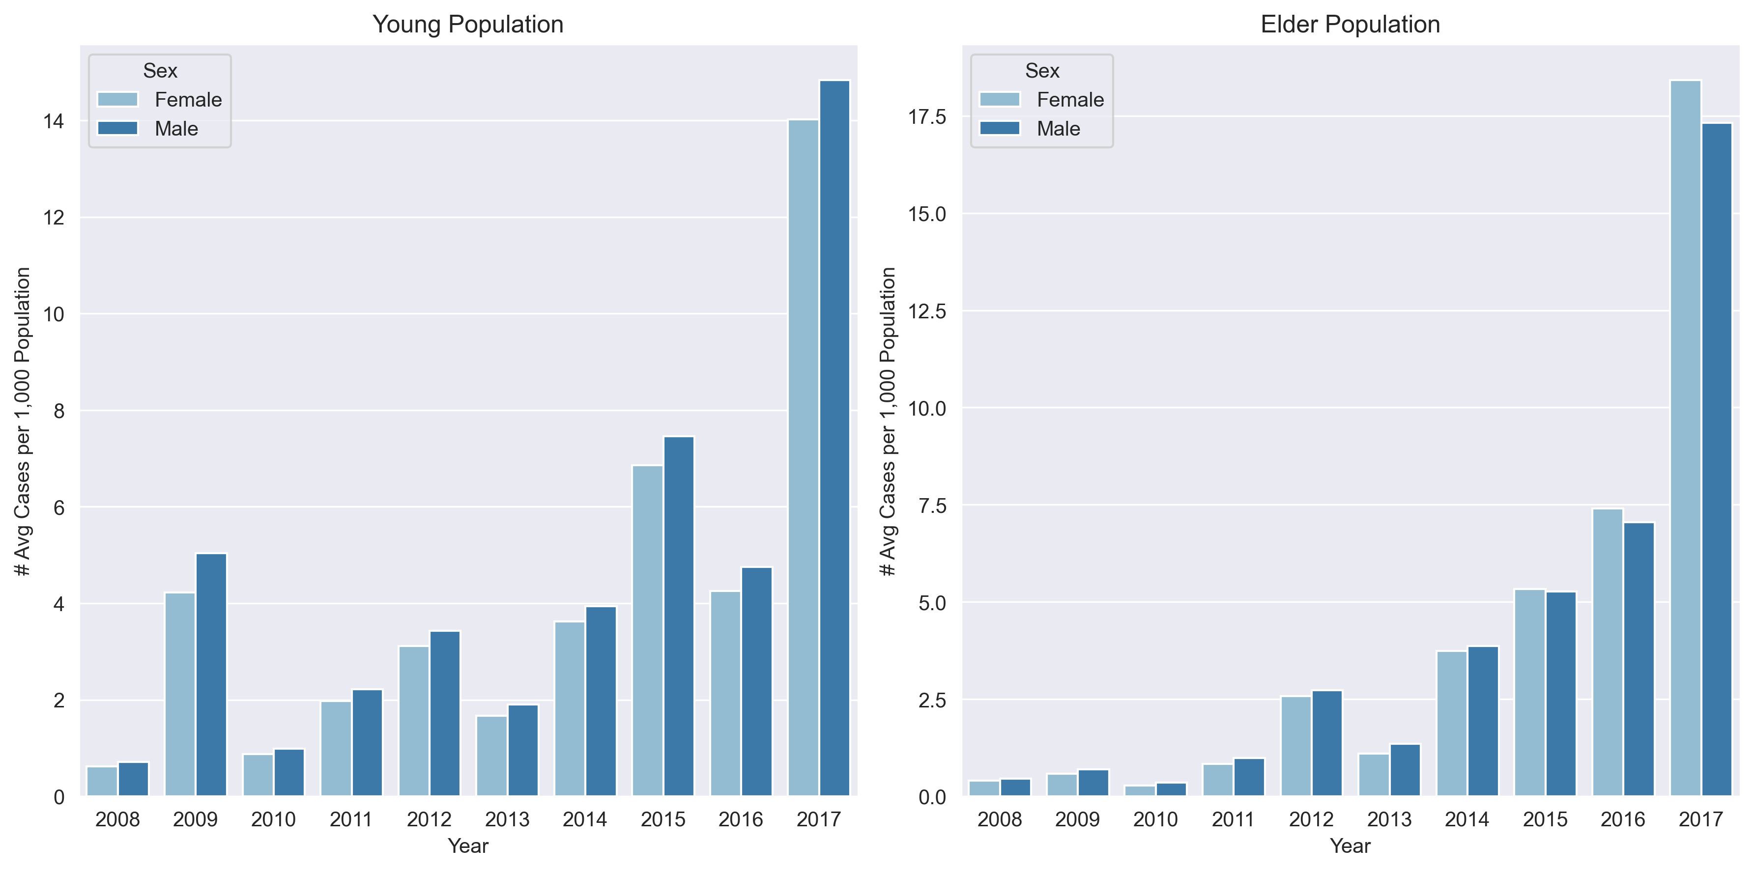
Young Male population are more vulnerable to influenza
Safer conclusion -> young population are very likely to seek medical help
This pattern reverts for elder population after 2015

Slide 14
Section 1: Insights exploration
1.3 State analysis

Slide 15
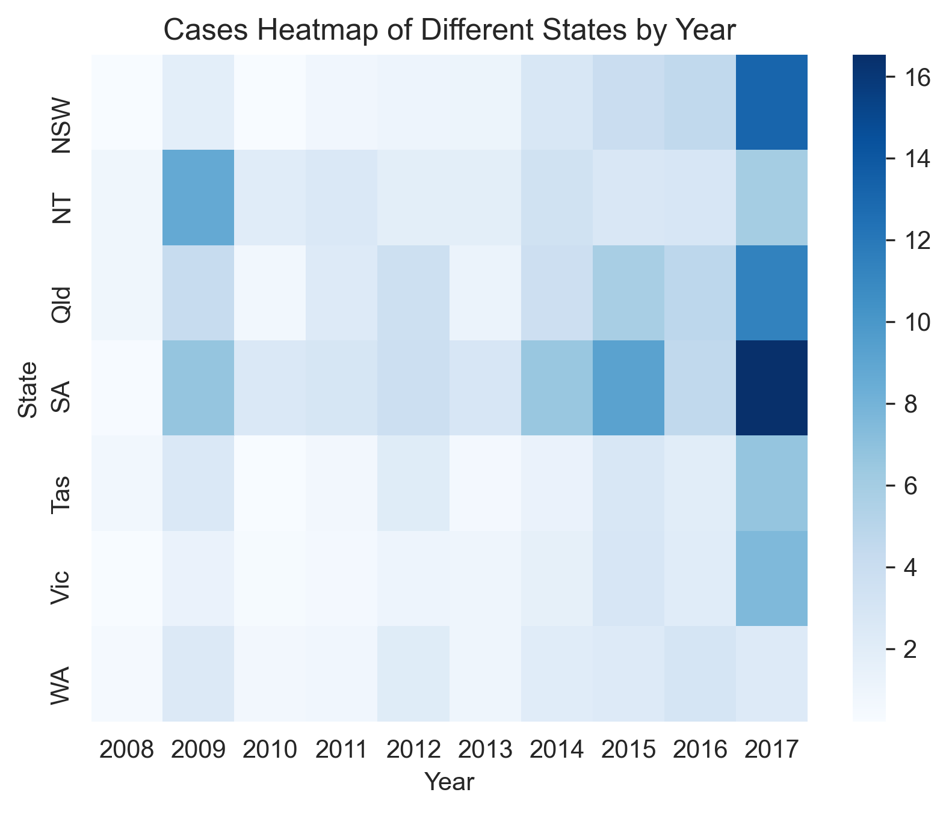
SA & QLD are major sufferers
Insights & Findings
SA and Qld generally suffered most from influenza seasons.
NSW was getting more affected compared to other states.
Need more research to find out possible reasons (e.g. SA is more severe due to low temperature in winter)

Slide 16
Influenza generally escalates first in Queensland
Absolute Case Count in May by Year and State
Insights & Findings
State | NSW | NT | Qld | SA | Tas | Vic | WA
Year
2008 | 90 | 2 | 106 | 6 | 6 | 22 | 34
2009 | 412 | 31 | 256 | 219 | 14 | 884 | 85
2010 | 53 | 1 | 72 | 12 | 5 | 40 | 25
2011 | 151 | 4 | 275 | 147 | 27 | 105 | 23
2012 | 191 | 34 | 238 | 94 | 4 | 97 | 119
2013 | 166 | 11 | 249 | 148 | 2 | 164 | 77
2014 | 272 | 12 | 520 | 137 | 21 | 294 | 140
2015 | 468 | 17 | 841 | 537 | 37 | 496 | 361
2016 | 585 | 16 | 611 | 121 | 17 | 252 | 234
2017 | 835 | 23 | 696 | 410 | 32 | 466 | 141
8/10 years QLD had the most confirmed cases in May.
No need to standardize on population -> mostly clustering infection at the beginning
Again need more research to find out possible reasons

Slide 17
Section 2: Predictive model for influenza

Slide 18
Potential issues & treatments
Main Issues for Predictive Modelling
Possible Treatments
Attributes such as Sex, Age group and State will not directly help to forecast -> very limited amount of data to use
Prediction will be largely influenced by outbreaks of certain type of influenza or pandemic, such as 2009 and 2017.
Difference in influenza situation across years is large but the source of variation is hard to capture
Create new features (future engineering) based on previous insights.
The influenza cases have a rather stable pattern from 2010 to 2016 -> use this period of data for modelling.
Use 2016 data for both model selection and testing, then check whether the model can predict extreme situation in 2017.

Slide 19
Response variable selection & feature engineering
Choice of Response Variable
Important Features to Include
Again predict the standardized infection rate instead of absolute count.
Different types of influenza have different up and downs over the years -> predict separately.
Group Types into A, B, A(H3N2), and Other -> Multioutput Regression.
Predict case per 1,000,000 population for good scale.
Seasonality
Month (one-hot encoding)
Measure in the same month last year
Cyclic
Binary indicator of whether last year was a historical peak of each influenza type
Aggregating Effect
Measure in the previous month
Population

Slide 20
KNN is the best model for 2016 influenza season
Modelling Results (for 2016 Jun – Nov)
Insights & Findings
Model | ElasticNet | KNN | Decision Tree | Random Forest
Total MAE | 8016 | 1698 | 4336 | 2428
Like mentioned previously, we model for 2016 influenza season first, where KNN has the least total MAE.
Major error comes from underfitting the general type A influenza cases in the peak months (Aug & Sep).
As expected, the model is not good at predicting 2017 influenza season, the total MAE jumps to 6909.
Sudden rise of cases in any particular year can influence the model a lot.
KNN Prediction True Error for Each Point
 | A(H3N2) | A(unsubtyped) | B | Other
Jun | 10.3 | 44.2 | 12.2 | 2.9
Jul | -17.2 | 61.0 | 25.7 | -6.5
Aug | -88.5 | -397.2 | 44.9 | 1.9
Sep | -45.8 | -598.2 | -2.5 | 9.3
Oct | 28.0 | 163.1 | 51.9 | 31.7
Nov | 16.8 | -31.3 | -4.9 | 1.9

Slide 21
Section 3: Limitations & future improvements

Slide 22
Summary of limitations & Improvements
Limitations
Improvements
Sudden rise of influenza is very hard to predict and will largely influence the accuracy of prediction model.
Human activities and behaviours are not fully understood with given data.
Lack of information of other possible drivers on the variation of influenza cases. (e,g. use of vaccine)
Get the data in longer period to consider trend and cyclic effect more accurately
Can potentially check more interactions (e.g. influenza situation by state, gender, age and type) with more data provided
Try other predictive models such as gradient boosting families.
Conclusion: It is very hard to find an accurate prediction model and we need to take care of hidden drivers in order to draw more solid insights.

Slide 23
Thank you

